Slide 1
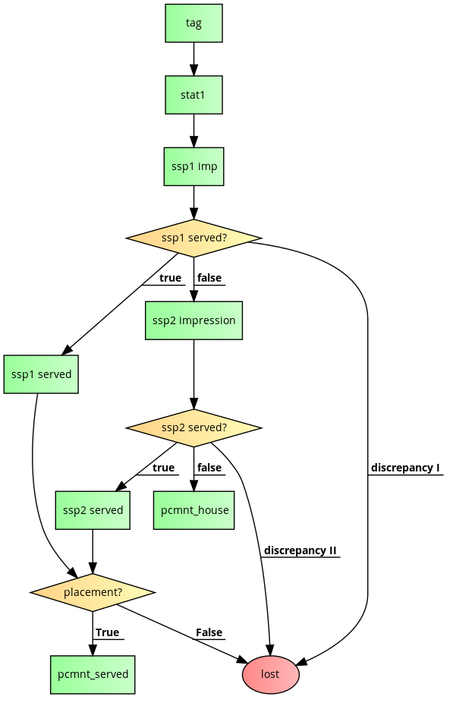
SSP1 imp – ssp1 served – ssp2 impression = discrepancy I
SSP2 imp – ssp2 served – pcmnt_house = discrepancy II
SSP1 served + ssp2 served – pcmnt_served = lost

Slide 2
|tag|;
stat1;
ssp1 imp;
switch (ssp1 served?) {
case true:
|ssp1 served|;
if (placement?)
|pcmnt_served|;
else
lost;
break;
case false: {
ssp2 impression;
switch (ssp2 served?) {
case true:
|ssp2 served|;
if (placement?)
|pcmnt_served|;
else
lost;
break;
case false:
|pcmnt_house|;
break;
case discrepancy II:
lost;
break;
}
}
break;
case discrepancy I:
lost;
}

